Slide 1
Object oriented programming
Iván Guerrero Román

Slide 2
Session #13
Today’s topics
4. Inheritance and polymorphism
a. Concept of inheritance
b. Access modifiers
c. Concept of polymorphism
d. Overriding and overloading
e. Abstract classes and interfaces

Slide 3
Inheritance
ParentClass
public class ParentClass {
…
}
Important
If X is a subclass of Y, then the objects of X can be stored in objects of Y
The tasks performed by the objects of Y can be performed by the objects of X
ChildClass
public class ChildClass extends ParentClass {
…
}

Slide 4
Inheritance
Object creation
ReferenceClass object = new CreationClass();
ReferenceClass is a class with which we have access to the object
CreationClass is a class with which we indicate the type of object that we are going to create
In multiple times, Reference and Creation classes are the same
Nevertheless, in OO languages, it is possible to use different classes.
Material myMaterial = new Movie();
Material myMaterial = new Viveogame();

Slide 5
ReferenceClass object = new CreationClass();
ReferenceClass determines the components (methods and attributes) that can be accessed with the object
CreationClass determines the object behavior (methods)
object
Created object
ReferenceClass

Slide 6
Example
Material myMaterial = new Material();
The object behaves like a Material object
myMaterial
Material object
Material
I have access to the methods and attributes of the Material class

Slide 7
Example
Material myMaterial = new Movie();
The object behaves like a Movie object
myMaterial
Movie object
Material
I have access to the methods and attributes of the Material class

Slide 8


What is this for?

Slide 9
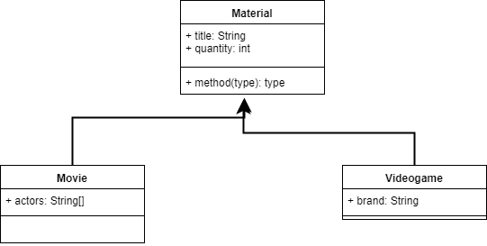
Imagine the following scenario

Slide 10

private Movie[] movies;
private Videogame[] games;
private int movieCounter, gameCounter;
public void addMovie(Movie m) {
movies[movieCounter] = m;
movieCounter++;
}
public void addVideogame(Videogame v) {
games[gameCounter] = v;
gameCounter++;
}
If we wanted to store all our movies and videogames, we would need two arrays.

Slide 11
But if we use inheritance…
private Material[] materials;
private int counter;
public void addMaterial(Material m) {
materials[counter] = m;
counter++;
}

Slide 12
Now we can store both movies and video games without duplicating code.

Slide 13
Session #13
Today’s topics
4. Inheritance and polymorphism
a. Concept of inheritance
b. Access modifiers
c. Concept of polymorphism
d. Overriding and overloading
e. Abstract classes and interfaces

